Slide 1
PLUGIN DEVELOPMENT: POPULAR POSTS PLUGIN
Name: Neha Bisht
JCNumber: JC446358
CP5637-BNE-INT-SP21

Slide 2
About Plugin
This Plugin is a popular posts plugin.
This plugin is used to count the number of views of a blog post whenever a post is visited or loaded.

Slide 3
Benefits of the Plugins
Blogging requires content management by focusing on what users like to read in blogs.
Helps in predicting the kind of posts viewed by users.
Popularity of blogs on the website and helping in better content management of posts.
Bloggers to come up with posts related to popular posts for getting more visitors and increase user engagement of the website.

Slide 4
Working Logic
To implement the plugin, we use customs field that appear below every post editor in the WordPress admin panel.
We will add a field called “views” in the customs field.
Whenever the posts are loaded, the “views” is incremented by 1.
Functions used:
1. my_popular_post_views: counts the number of post views and updates the ‘views’ field whenever the post is loaded/visited.
2. my_count_popular_posts:gets the post_id of the post and returns it to my_popular_post_views function.

Slide 5
Working Login
3. My_add_views_column: adds the custom field ‘views’ to the column in the admin panel.
4. My_display_views: displays ‘views’ in the post meta data.
Widget:
1. Popular_posts: assigns a widget to the plugin that can be used in any widget area available in the theme.
WP query:
1. $query_args:Takes the permalink and views of the post and displays it on the widget area.

Slide 6
Working Environment
Used Brackets
Added code under wp_content->plugin folder
Inside this folder created a plugin php file called popular_posts_plugin.php

Slide 7
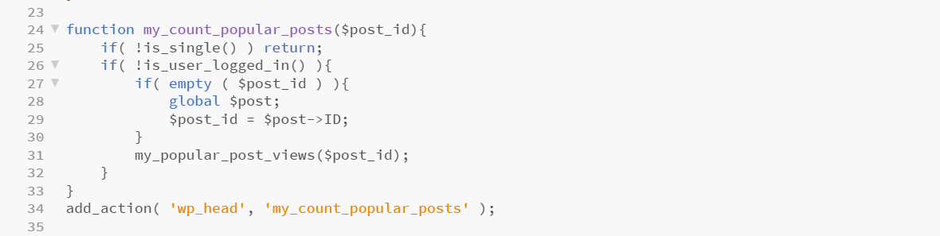
Implementation
My_count_popular_posts:

Slide 8
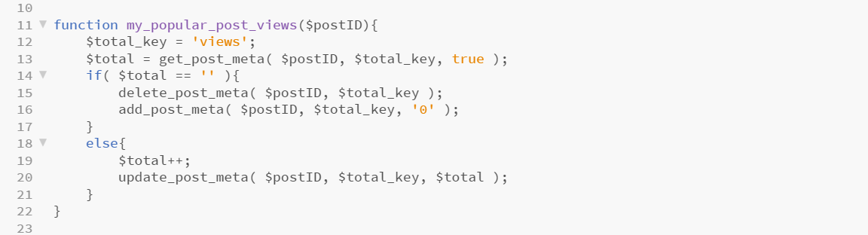
Implementation
My_popular_post_views

Slide 9
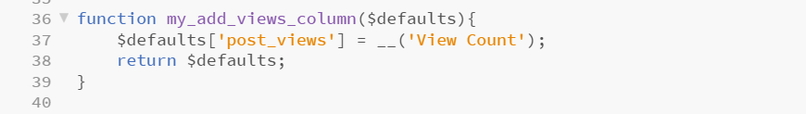
Implementation
My_add_views_columns

Slide 10
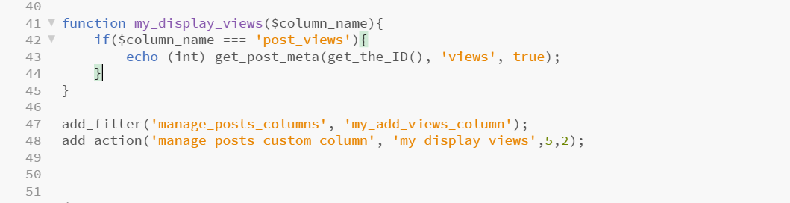
Implementation
My_display_views($column_name)

Slide 11
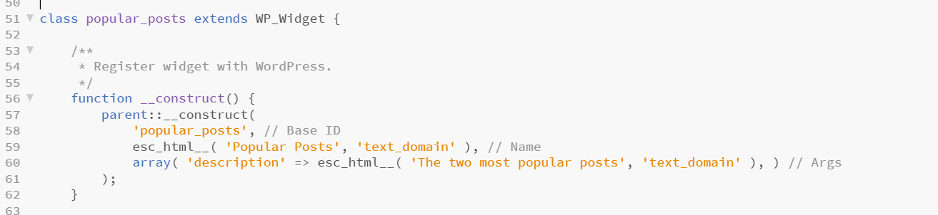
Implementation
Widget: popular_posts

Slide 12
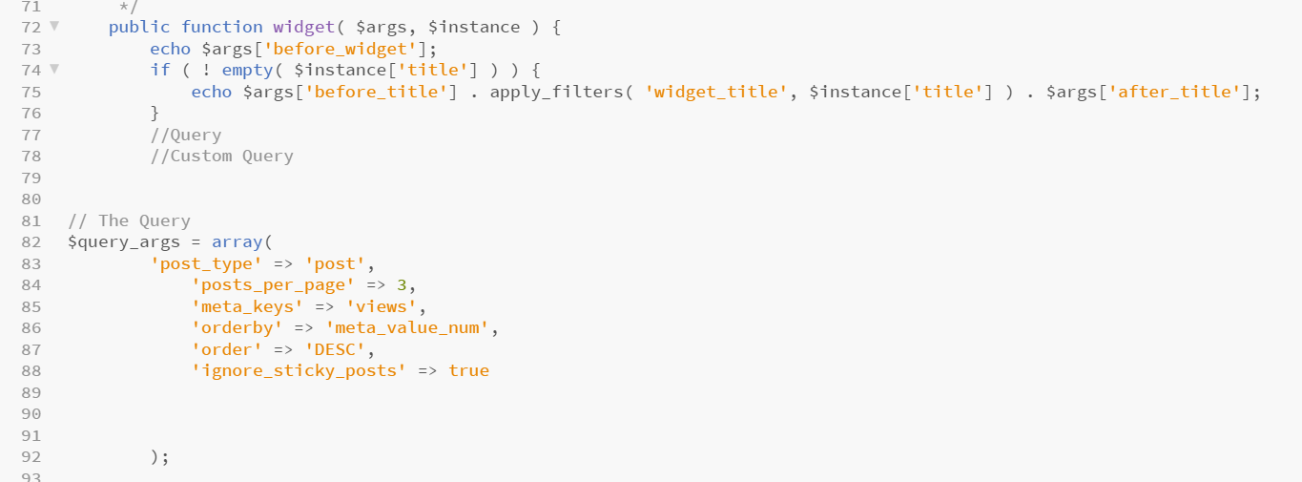
Implementation
WP_query

Slide 13
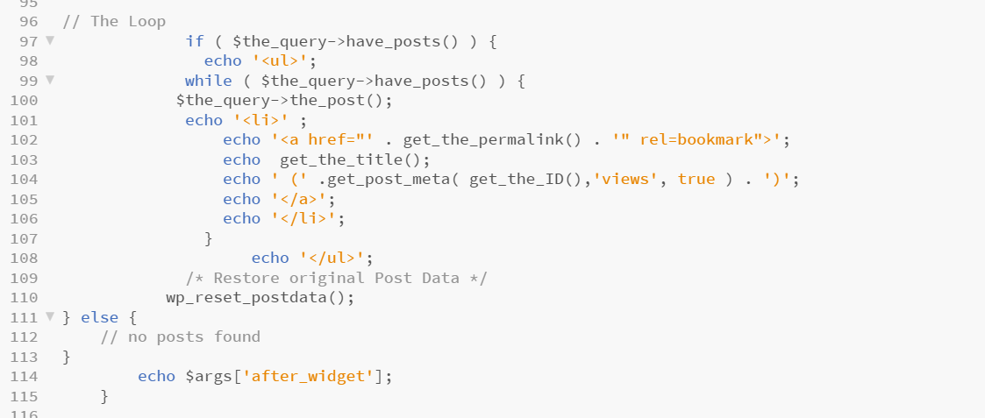
Implementation
WP_query

Slide 14
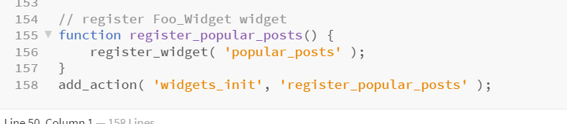
Implementation
Register widget

Slide 15
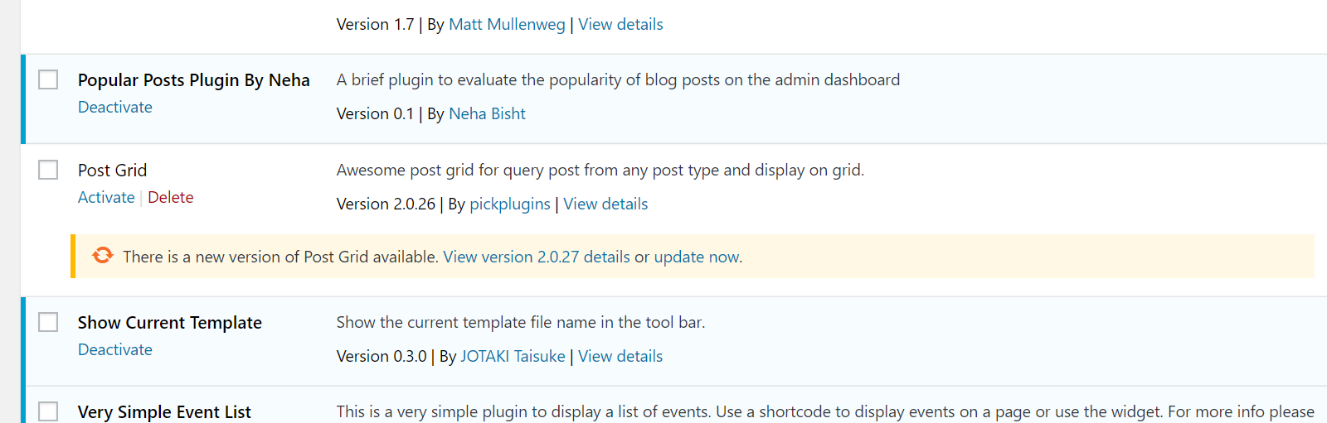
Demonstrated Screenshots: Installed Plugin

Slide 16
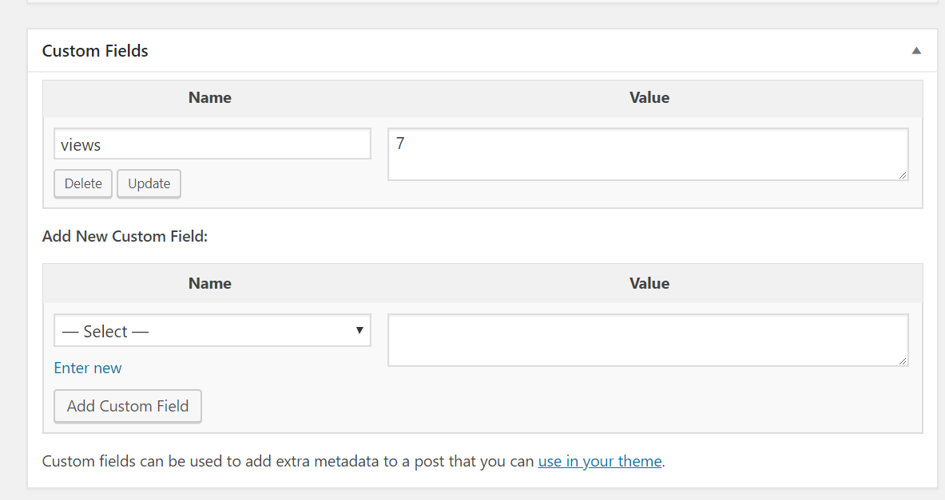
Demonstrated Screenshots: Added views field

Slide 17
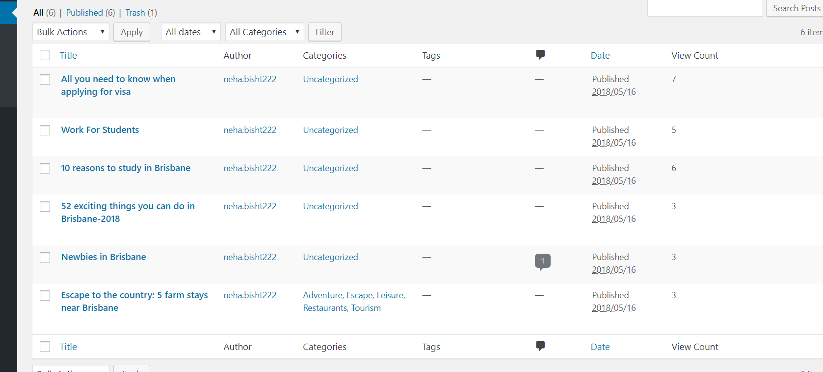
Demonstrated Screenshots: Added Views column in posts page

Slide 18
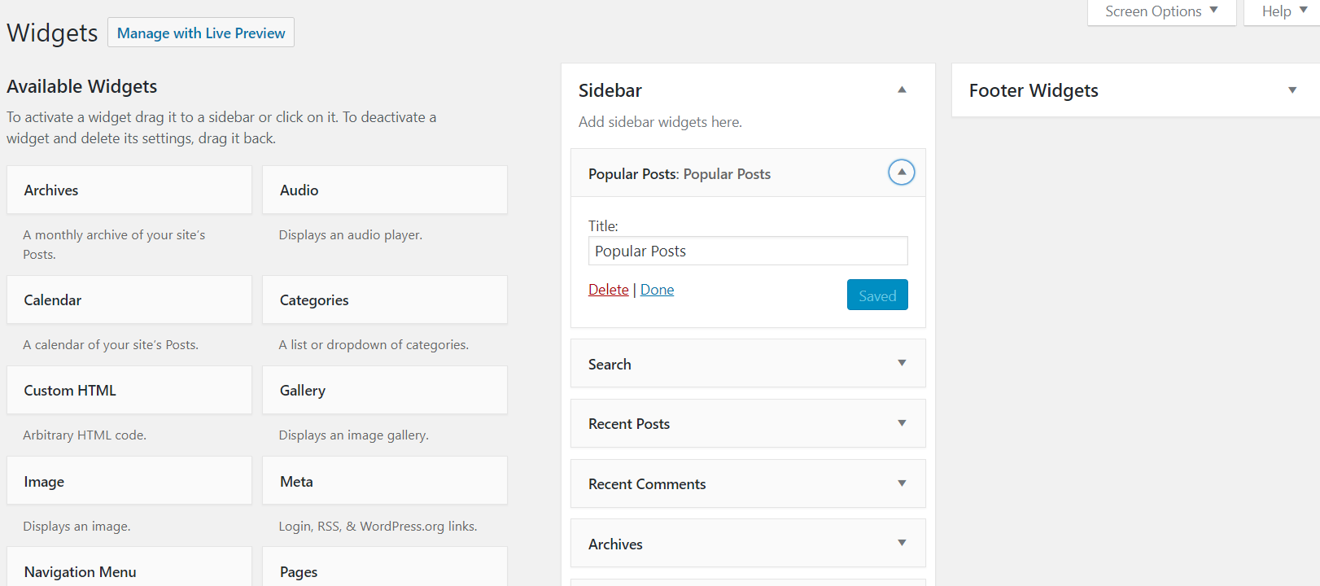
Demonstrated Screenshots: Added Widget of plugin

Slide 19
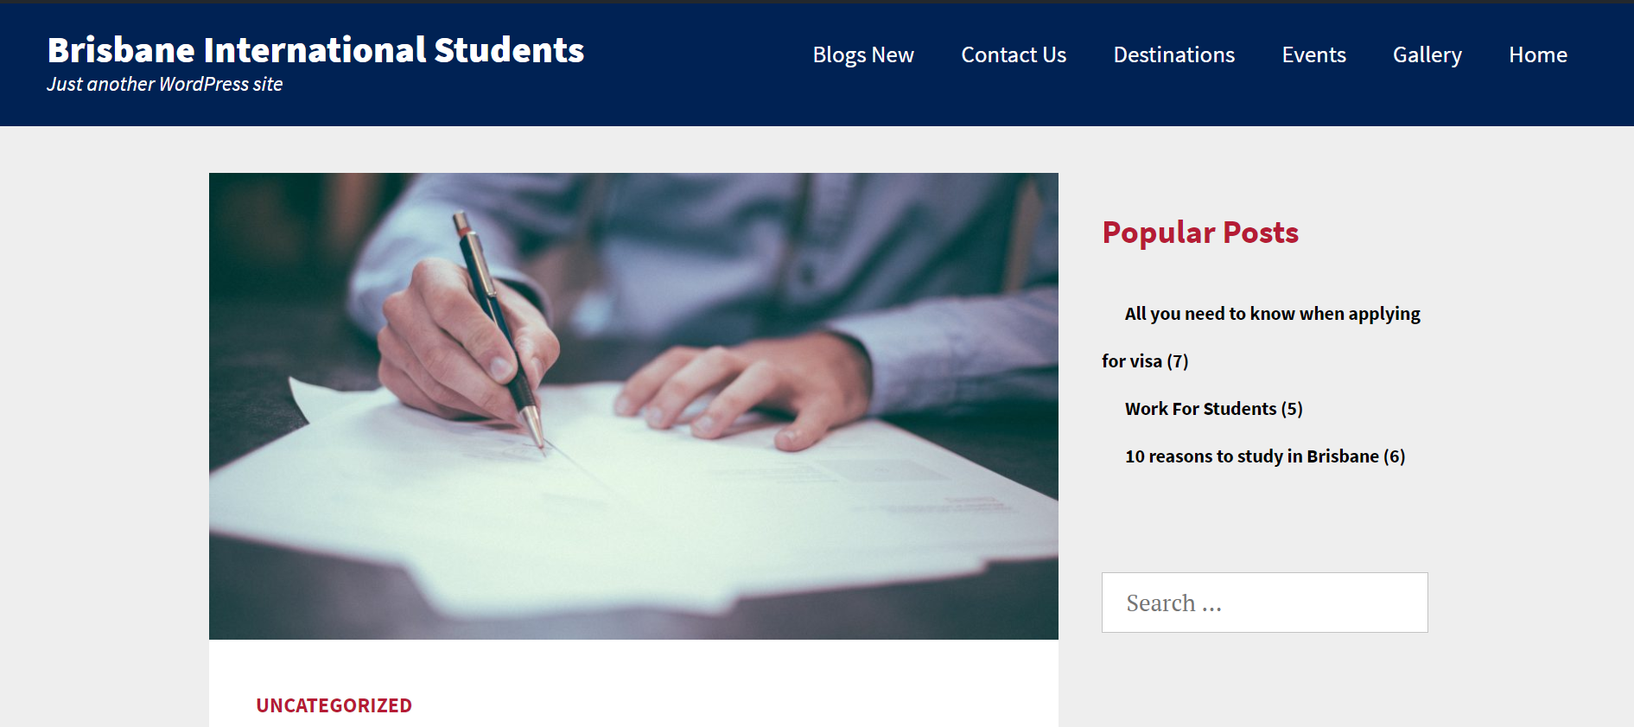
Demonstrated Screenshots: Widget containing 3 most popular posts in website’s blog page

Slide 20
ThankYou

